Slide 1
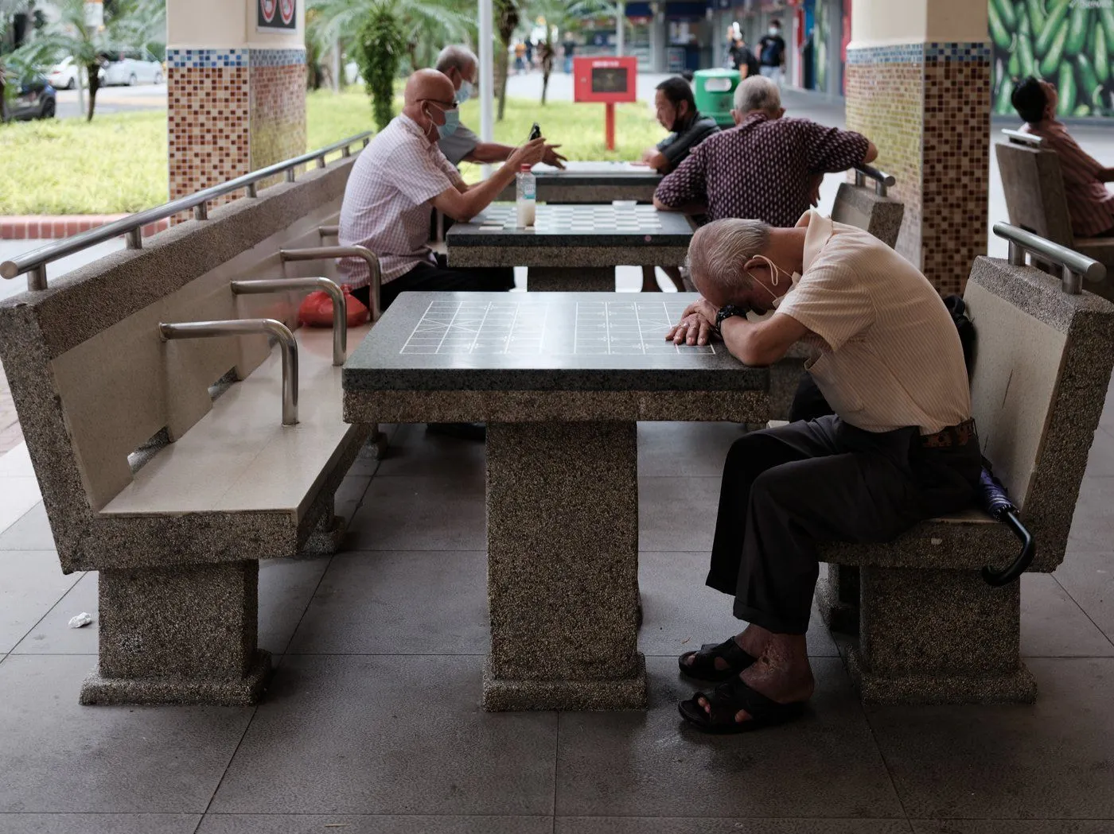

Slide 2
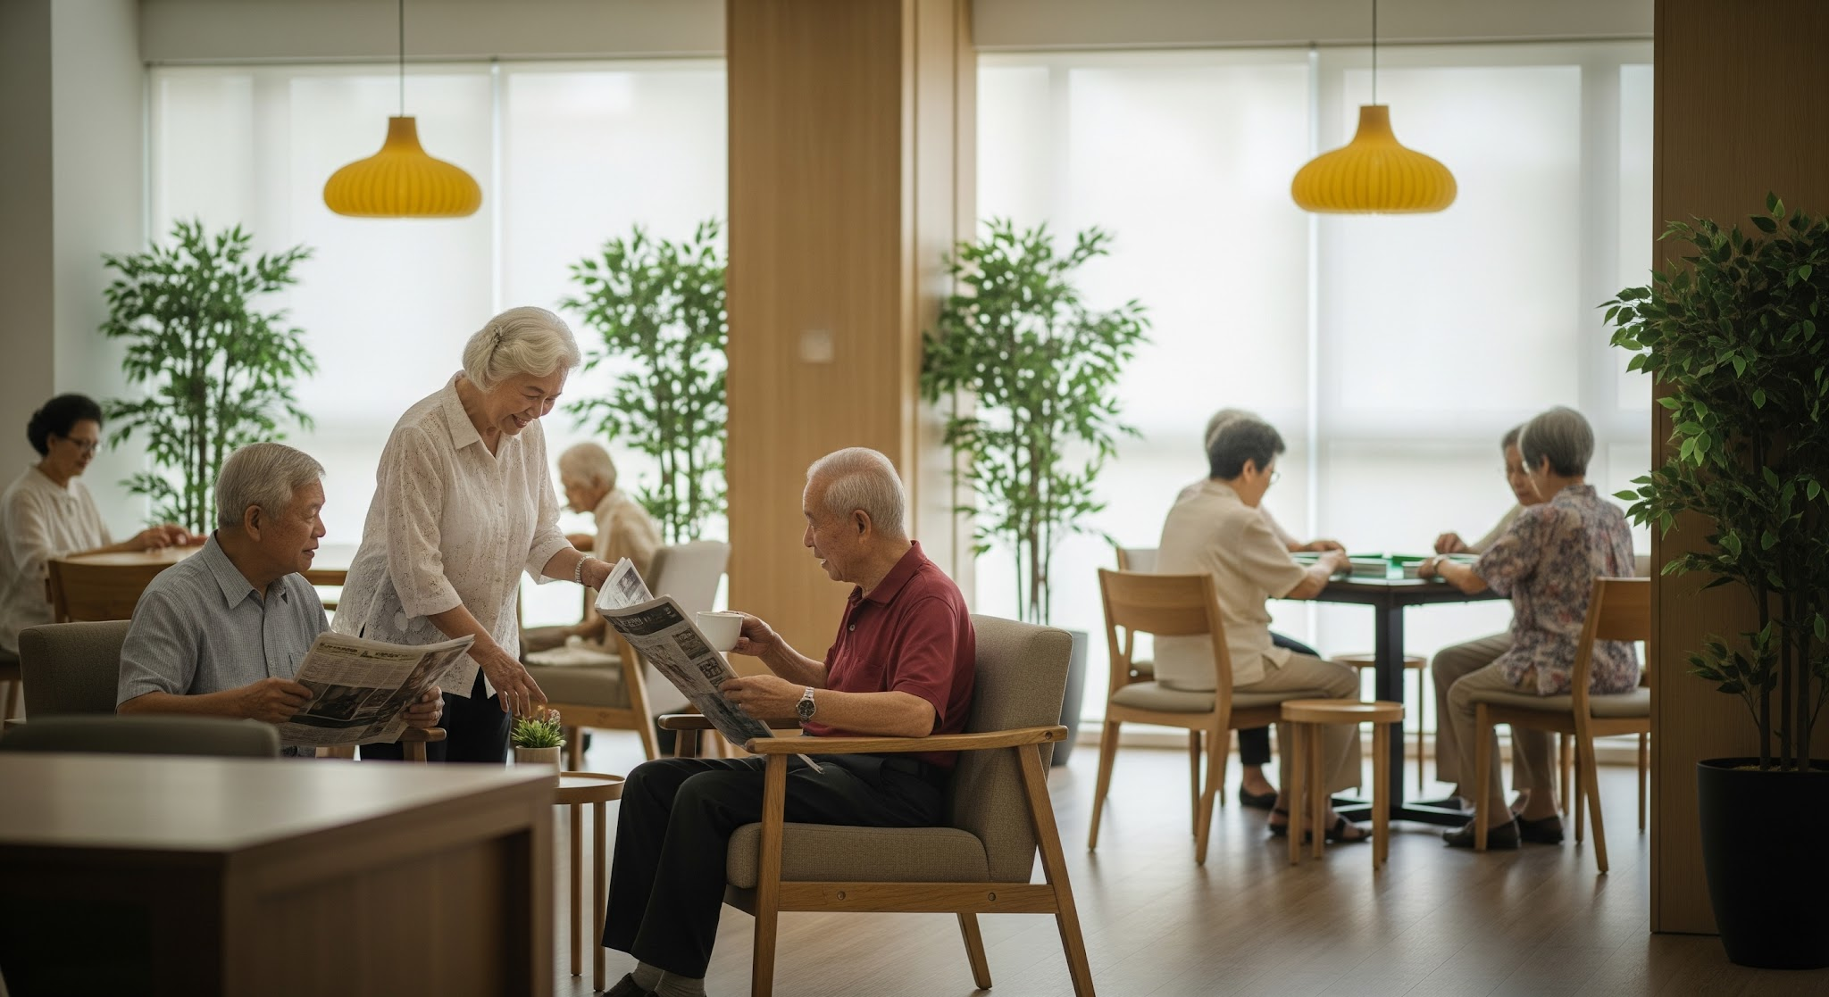

Let us look at some stats…
1B+
GLOBAL ELDERLY POPULATION
By 2030, 24% of Singaporeans will be 65+. Globally, the elderly population will hit 1 billion milestones.
UN WPP 2024 / SINGSTAT
3-5y
LIFE EXPECTANCY GAIN
Strong social connections lead to significantly better health outcomes and longer lives.
WHO REPORT 2025
80%
HIDDEN ISOLATION
Of elderly Singaporeans reporting social disconnection were living WITH family members, proving co-residence is not a cure.
DUKE-NUS 2021

Slide 3
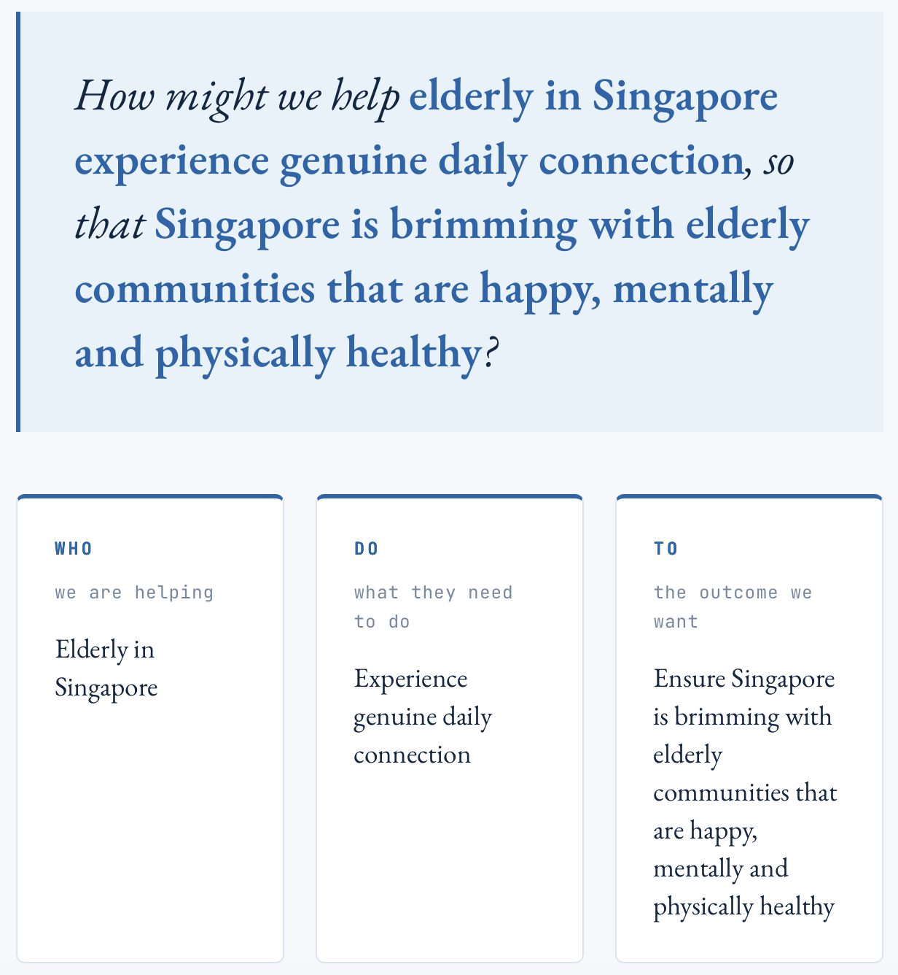

Slide 4
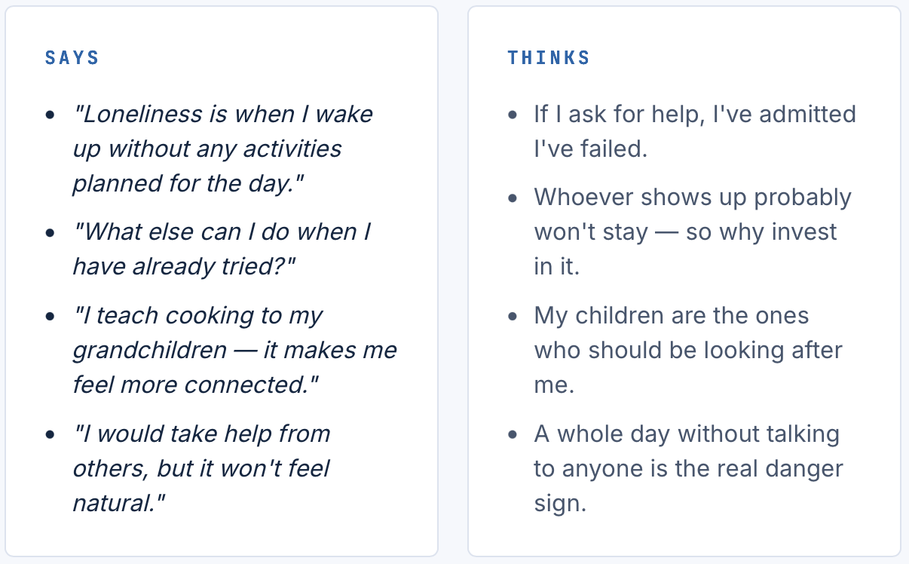
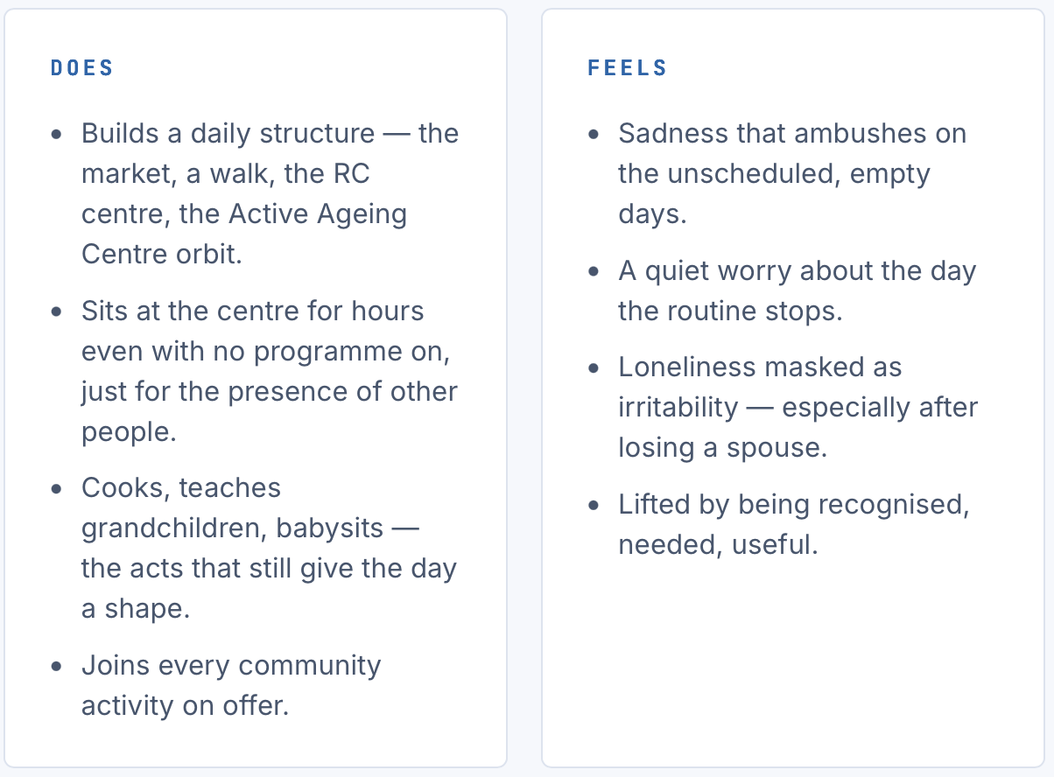
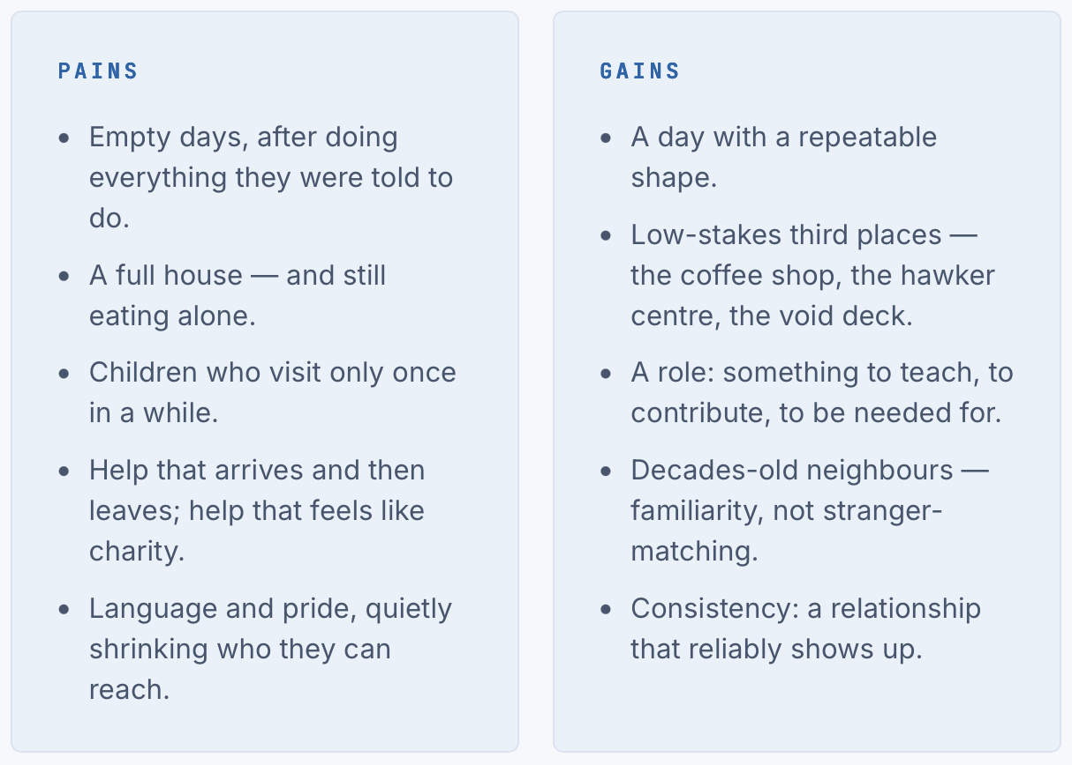

Slide 5
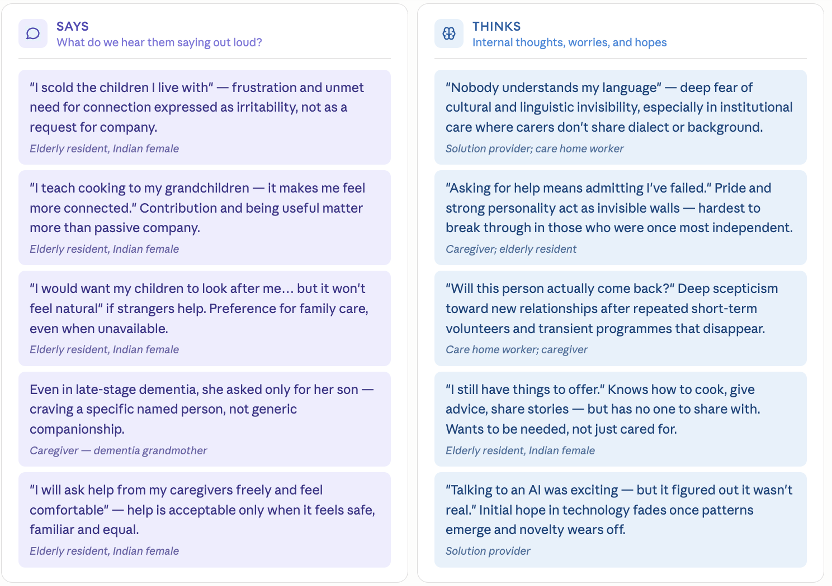
Empathy Map

Slide 6
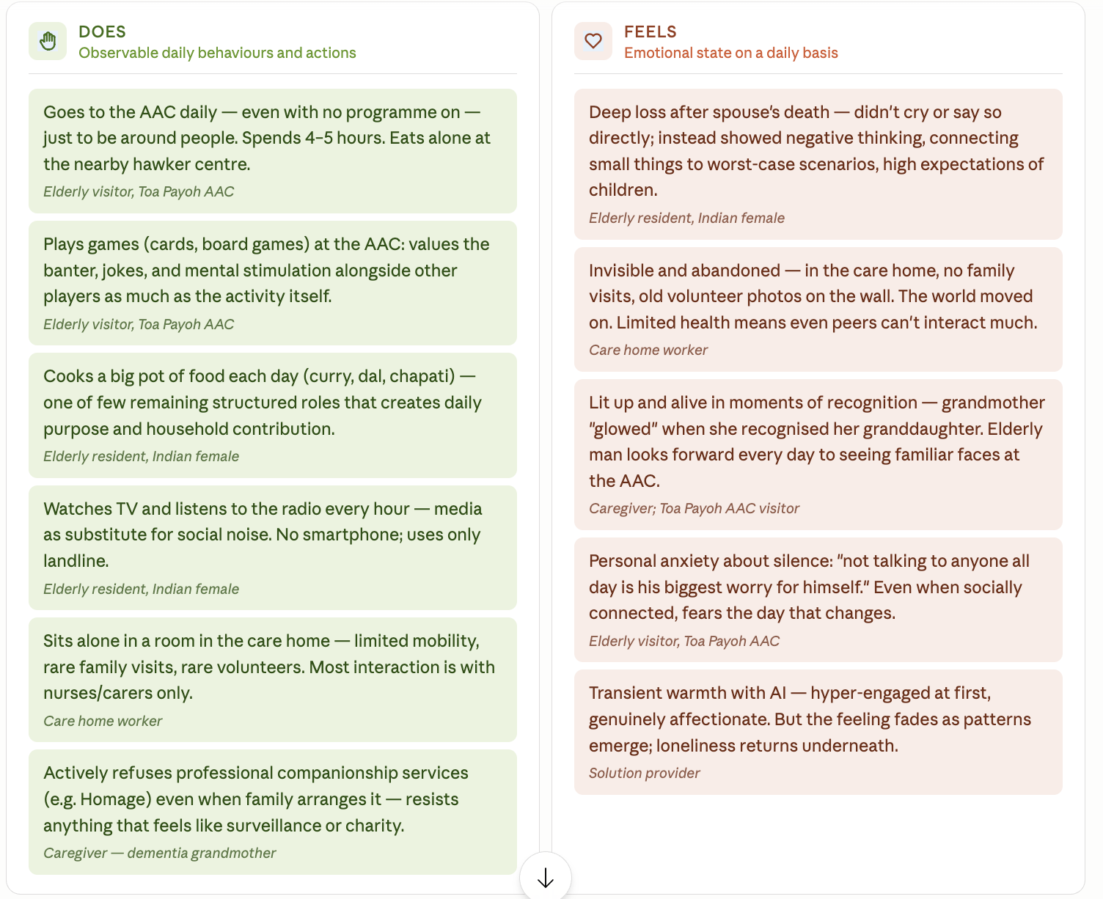
Empathy Map

Slide 7
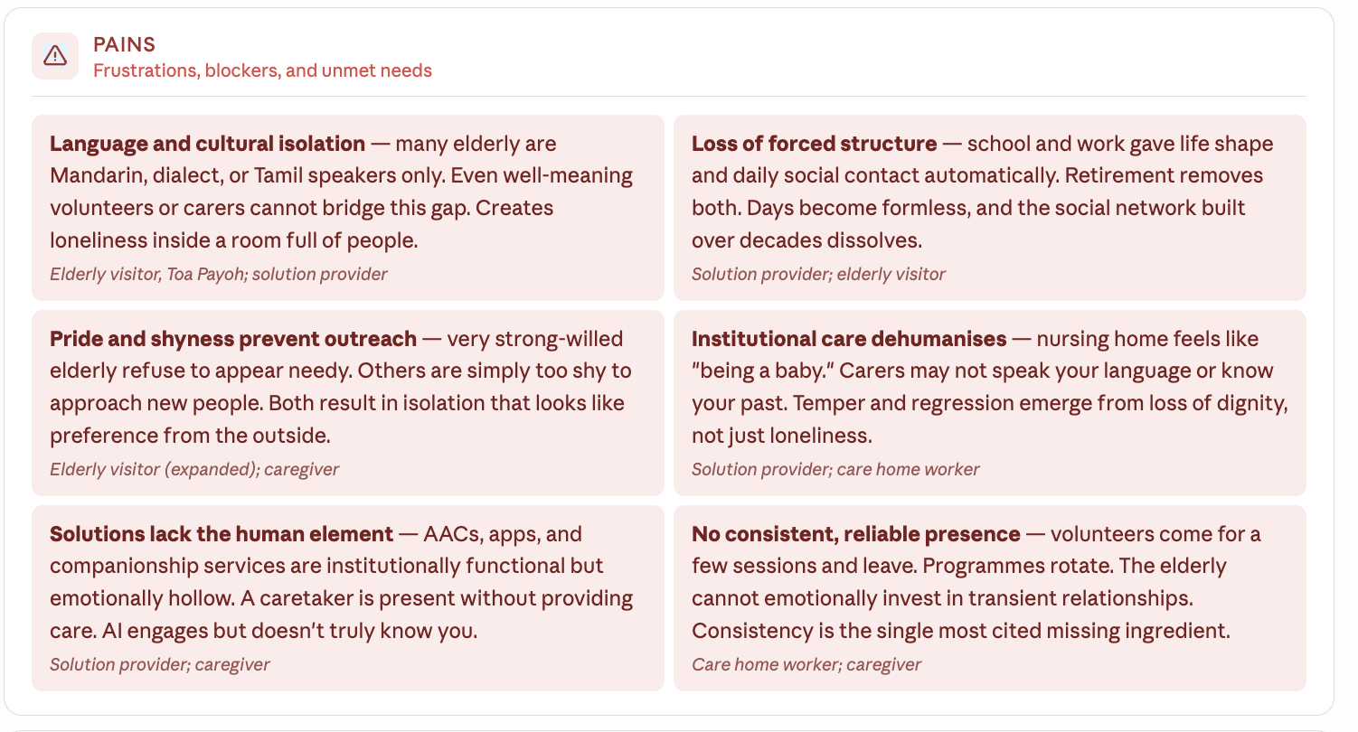
Empathy Map

Slide 8
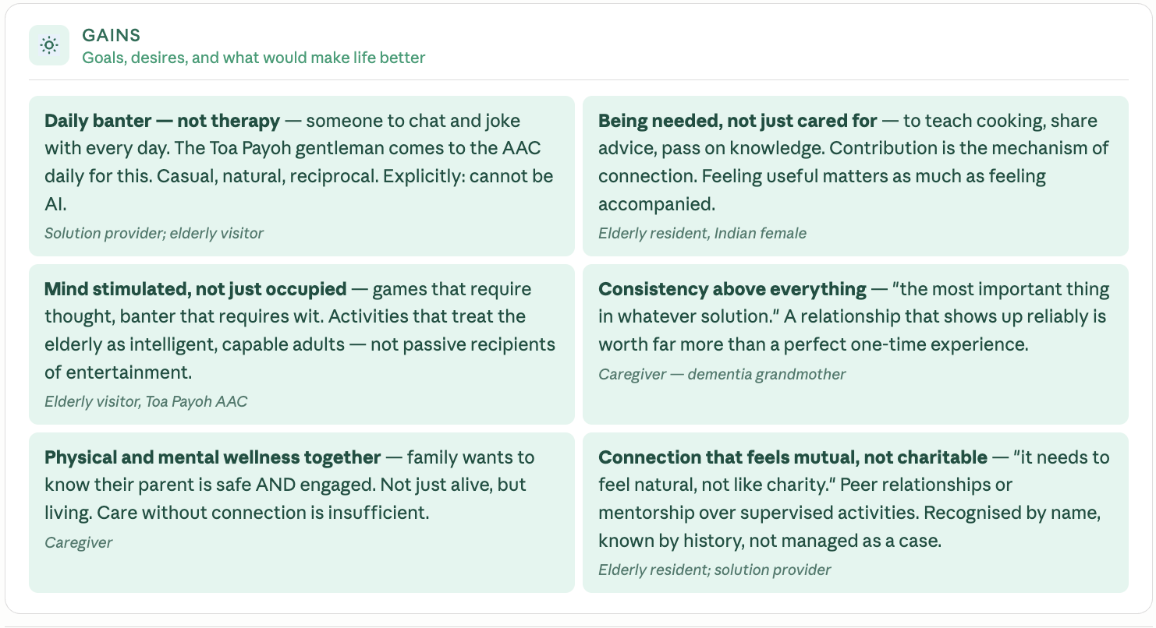
Empathy Map

Slide 9
Narrative for 2026-05-26 Tue Presentation
Why / Purpose
[ZW - 1 min] Real Story on caregiver
Elderly stayed alone with caregiver. While caregiver away at work, elderly is unable to even open/close doors, and ended up hungry through the day
Multiple solutions explored, but the only recourse was to send elderly to a nursing home.
Although unspoken, Elderly craves connection, often lighting up once caregiver visits and asks for her only son.
[SS - 1 min] Real story on the elderly that we interview
Elderly staying with his wife but not working any more. Feels disconnected from the world due to loss of routine and social imagery he had for himself
Started going to Active Ageing centers around his HDB deck. He goes there every day for 4-5 just to connect with people even when there is no activity planned. So goes there to talk to others, play some games to keep his cognitive abilities alive. He wants to ensure he remains ‘seen’ and not forgotten. These daily connections help him be seen
[AA - 1 min] Did you know … (3 Key Stats)
Super aging population -- by 2030, 24% will be 65+ ⇒ Globally, by 2030, 1B!
WHO acknowledged that “loneliness”/ <> life expectancy
_____
Turns out, it is actually a very complex problem -- Not “just” a loneliness or aging problem
Who are we focused on
[AK - ½ min]
SO we’re focusing on elderly!
“How might we help elderly in Singapore experience genuine daily connection? So that Singapore is brimming with elderly communities that are happy, mentally and physically healthy.
Empathy Map
[LY - 1 min] Show

Slide 10
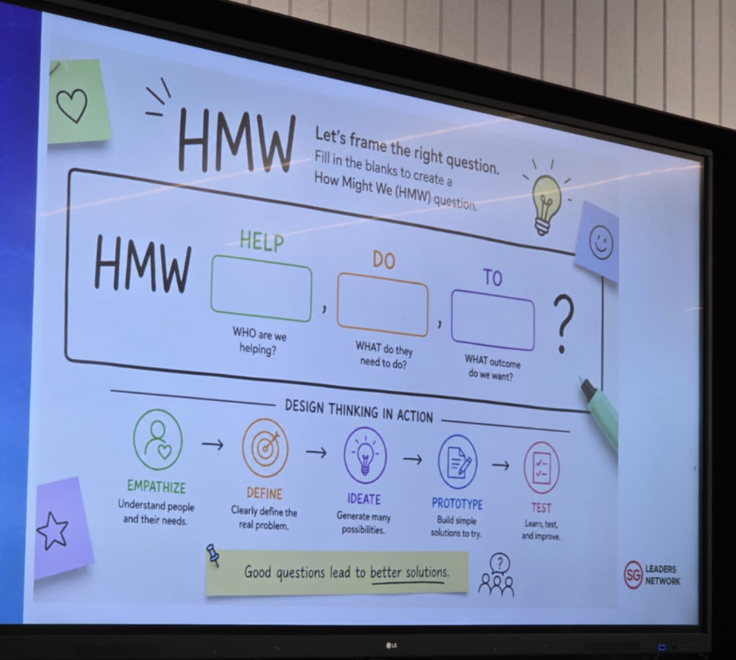

Slide 11
HELP
DO
TO
WHO are we helping
WHAT do they need to do
WHAT outcome do we want
Elderly in singapore
To feel less lonely
And feel part of the society, improve their quality of life, stay healthy to reduce healthcare burden / problems with ageing society
AA
Elderly in Singapore that are not working and living without kids / grandkids
Feel connected with the society
To improve ageing experience (metric?) and increase life expectancy
SS
AK
Elderly in Singapore who are staying alone (couple)
To age with a close family member
To age happily
To age with purpose
ZW
Socially isolated elderlies
Experience genuine daily connection
To feel seen, needed, and alive.
ZW
Lonely elderlies
Find meaningful companionship
To live longer, healthier lives without dependency.
LY
Elderly in Singapore - who are sick/healthy, rich/poor, social/introverted, happy/sad
They need to have a sense of belonging, a sense of assurance that they are not alone or left behind
To ensure that Singapore is brimming with elderly communities that are happy, mentally/physically healthy

Slide 12
AIs for this one week
AA -
PIC for Interview with …
SS - PIC for Presentation for 26th May
PIC for Interview with …
ZW - PIC for Research Orchestration
PIC for Interview with …
LY - PIC for Google Drive → Org & Process
PIC for Interview with …
AK - PIC for GitHub + Website Launch (host via Vercel)
PIC for Interview with …
Notes:
https://www.touch.org.sg/get-assistance/tips-and-articles/impact-of-social-isolation-and-loneliness-on-seniors.html

Slide 13
Flow of micro site
Problem Space : Why this problem is big and important : Partially covered
Singapore elderly population stats (cover global as well)
Loneliness - definition and trends
Why : health effect of Loneliness and causes of Elderly Loneliness
Existing programs / resources
Discovery : To add who we have spoken to, what did we observe
Personas we have spoken to, Quotes from people, Photos / audio recordings
HMW statement - covered under Question on microsite
Empathy Map - To add
Journey - partially covered, add more based on today’s discussion

Slide 14
Personas we have spoken to
Elderly
Direct caregiver
Solution providers
Living with daughter and family
Living with wife only
Grandchild whose grandma is showing early signs of dementia. Living with grandma now
Solution Provider
Caretaker of an old age home

Slide 15
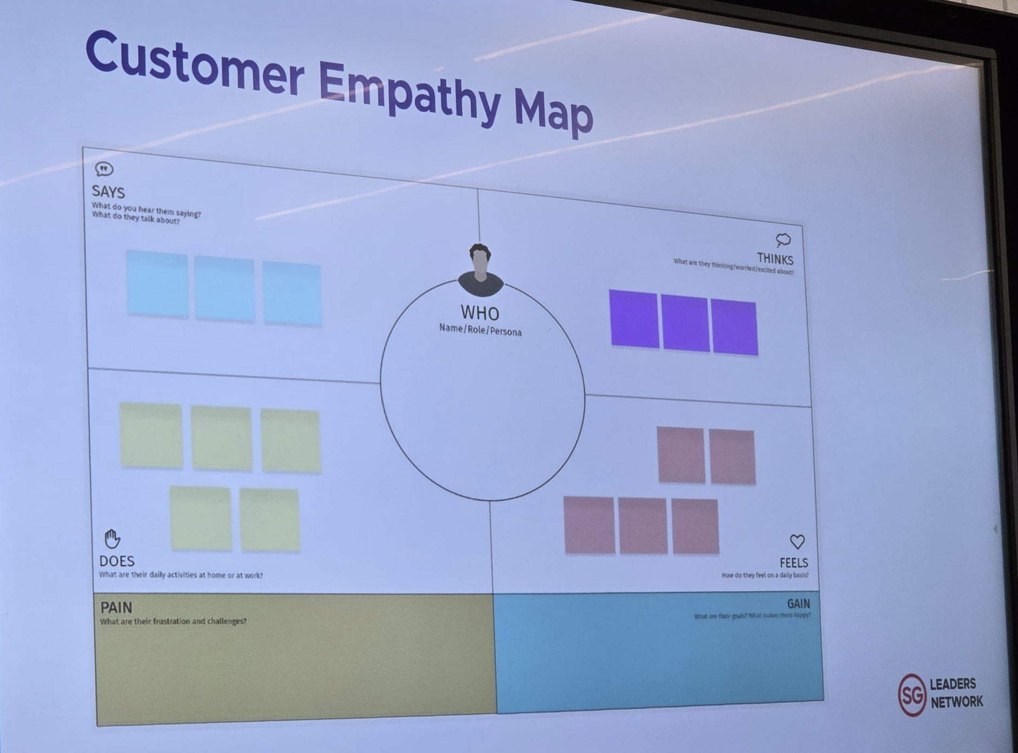
Empathy Map

